Slide 1
Practice Problems (Cont. R.V & Joint Dist)

Slide 2
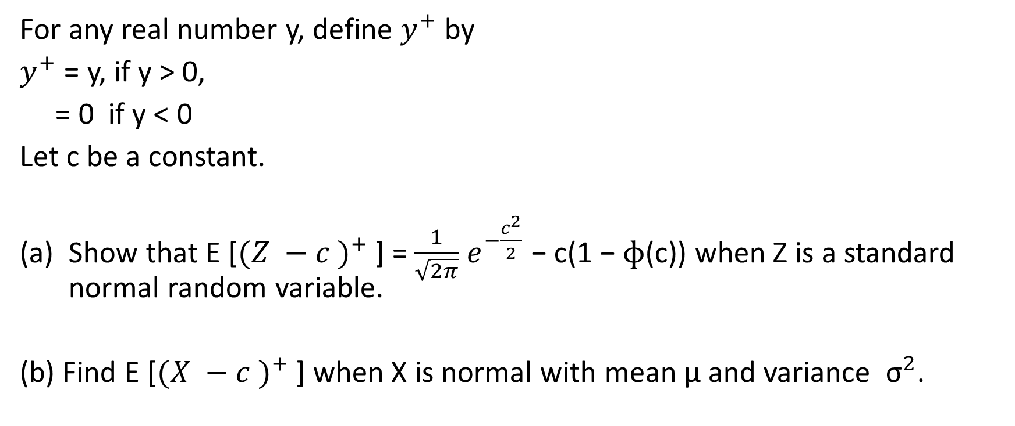
Practice Problem 1
For any real number y, define $y^{+}$ by
$y^{+}$ = y, if y > 0,
= 0 if y < 0
Let c be a constant.
Show that E [${(Z −c )}^{+}$ ] = $\frac{1}{\sqrt{2π}}$ $e^{−\frac{c^{2}}{2}}$ − c(1 − $ɸ$(c)) when Z is a standard normal random variable.
(b) Find E [${(X −c )}^{+}$ ] when X is normal with mean μ and variance ${\text{σ}}^{2}$.

Slide 3
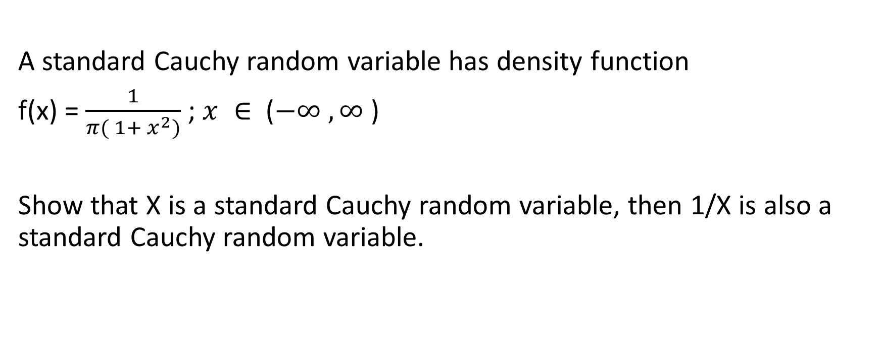
Practice Problem 2
A standard Cauchy random variable has density function
f(x) = $\frac{1}{π( 1+ x^{2})}$ ; $x ∈$ ($−∞ , ∞$ )
Show that X is a standard Cauchy random variable, then 1/X is also a standard Cauchy random variable.

Slide 4
Practice Problem 3
If X is uniformly distributed over (−1, 1), find
P{|X| > 1/2 }
(b) the density function of the random variable |X|.

Slide 5

Practice Problem 4
If Y is uniformly distributed over (0, 5), what is the probability that the roots of the equation 4$x^{2}$ + 4$x$Y + Y + 2 = 0 are both real?

Slide 6

Practice Problem 5
If X is uniformly distributed over (0, 1), find the density function of
Y = $e^{X}$

Slide 7
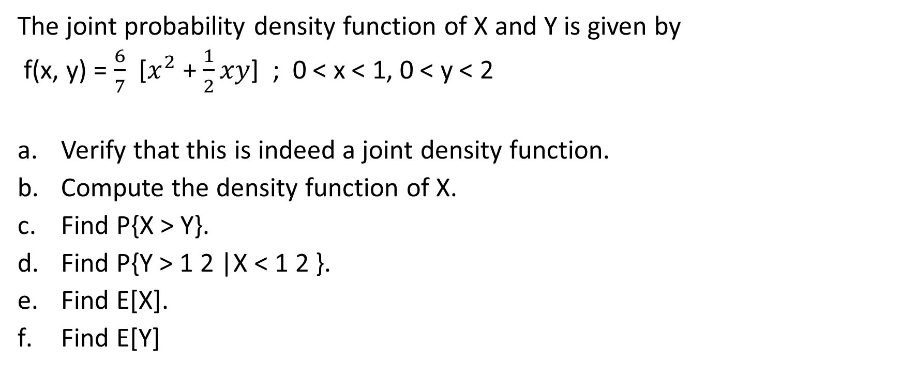
Problem 6
The joint probability density function of X and Y is given by
f(x, y) = $\frac{6}{7}$ [$x^{2}$ + $\frac{1}{2}xy$] ; 0 < x < 1, 0 < y < 2
Verify that this is indeed a joint density function.
Compute the density function of X.
Find P{X > Y}.
Find P{Y > 1 2 |X < 1 2 }.
Find E[X].
Find E[Y]

Slide 8
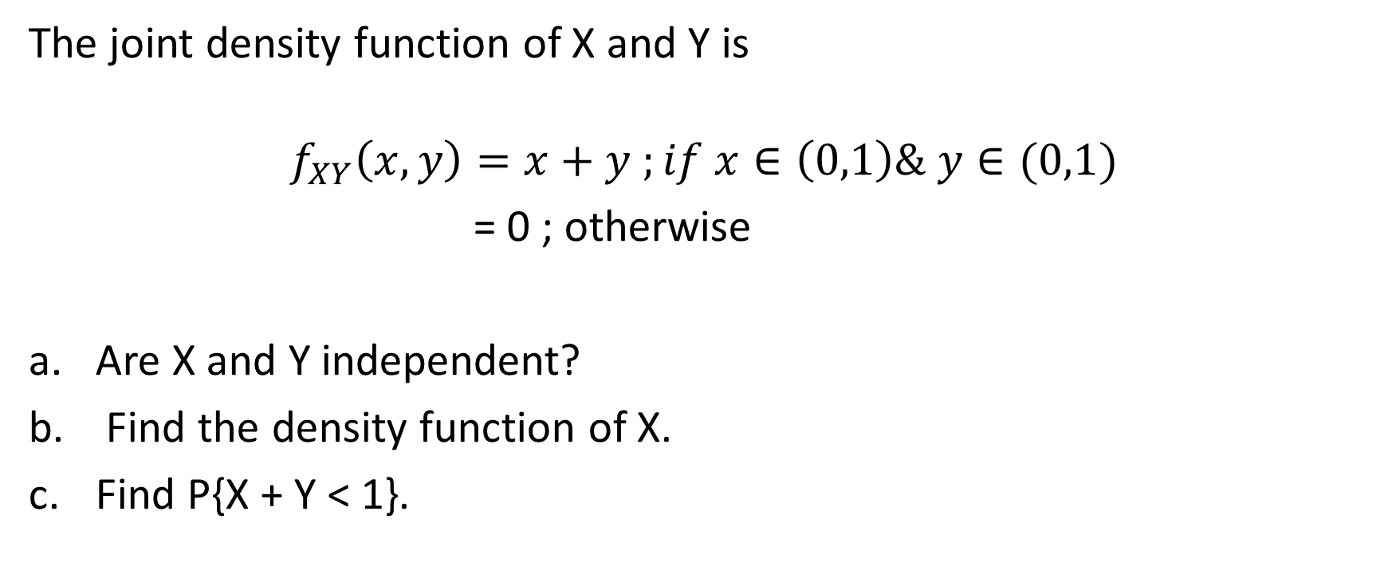
Problem 7
The joint density function of X and Y is
$$f_{XY}\left(x,y\right)=x+y ;if x∈\left(0,1\right)\& y∈(0,1)$$
= 0 ; otherwise
Are X and Y independent?
Find the density function of X.
Find P{X + Y < 1}.

